Slide 1
DESIGN AND ANALYSIS OF APPROXIMATE 4-2 COMPRESSORS FOR HIGHACCURACY MULTIPLIERS
Aakarsh Dev MT2021501
Animesh Kumar Tiwari MT2021505
Under the guidance of Dr. Madhav Rao

Slide 2
COMPARISON OF 4-2 COMPRESSORS
COMPRESSOR | AREA (μm²) | GATES | TIMING (ps) | POWER (nW)
PRO 1 | 15.39 | 9 | 353 | 205
PRO 2 | 13.68 | 8 | 340 | 173
PRO 3 | 10.26 | 5 | 439 | 127
PRO 4 | 12.31 | 8 | 312 | 149
PRO 5 | 9.91 | 7 | 305 | 94

Slide 3
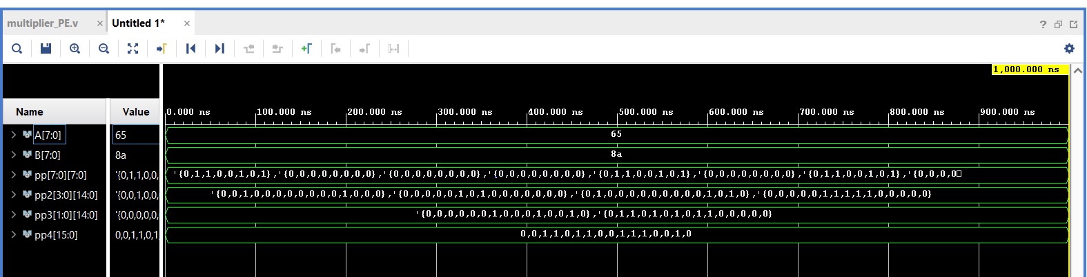
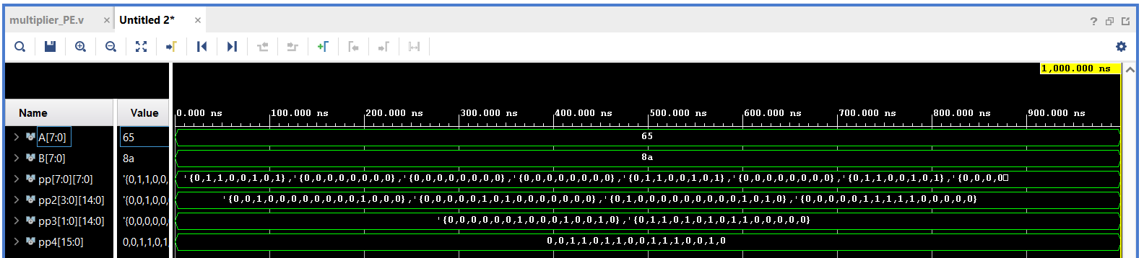
8 BIT MULTIPLIER USING EACH COMPRESSOR
USING PRO 1
USING PRO 2

Slide 4
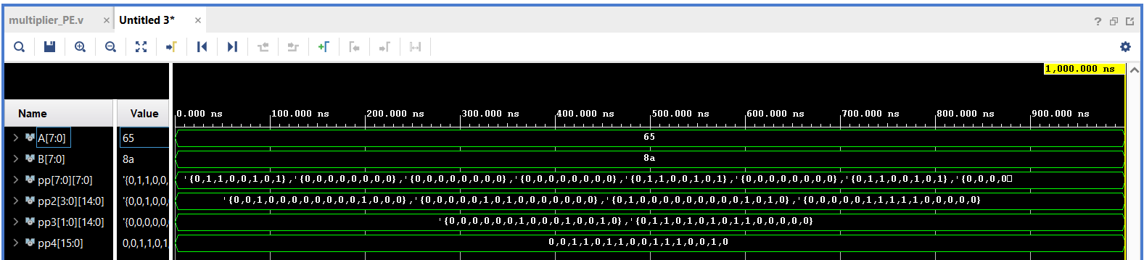

8 BIT MULTIPLIER USING EACH COMPRESSOR
USING PRO 3
USING PRO 4

Slide 5
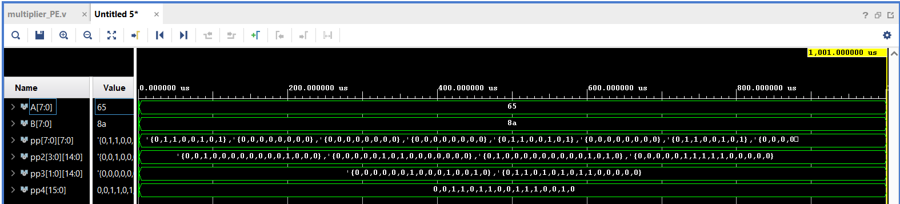
8 BIT MULTIPLIER USING EACH COMPRESSOR
USING PRO 5

Slide 6
COMPARISON OF 8 BIT MULTIPLIER
MULTIPLIER USING DIFFERENT COMPRESSORS | AREA (μm²) | GATES | TIMING (ps) | POWER (μW)
PRO 1 | 401.16 | 218 | 2845 | 7.59
PRO 2 | 392.27 | 199 | 2828 | 7.63
PRO 3 | 392.95 | 200 | 2931 | 7.62
PRO 4 | 392.95 | 200 | 2922 | 7.62
PRO 5 | 366.62 | 199 | 2920 | 7.51

Slide 7
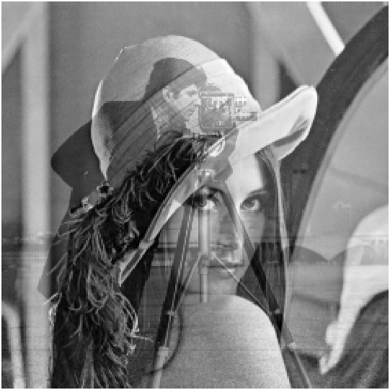
IMAGE BLENDING APPLICATION
USING DIFFERENT COMPRESSORS | PEAK SIGNAL TO NOISE RATIO PSNR (dB)
PRO 1 | 61.78
PRO 2 | 59.88
PRO 3 | 55.27
PRO 4 | 55.27
PRO 5 | 61.78
Blended image of Lena and Cameraman with the help of the 8 bit multiplier using Pro 5 compressor.
α is taken as 0.3 here
blended(x) = (1−α)*Lena(x) + α*Cameraman(x)

Slide 8
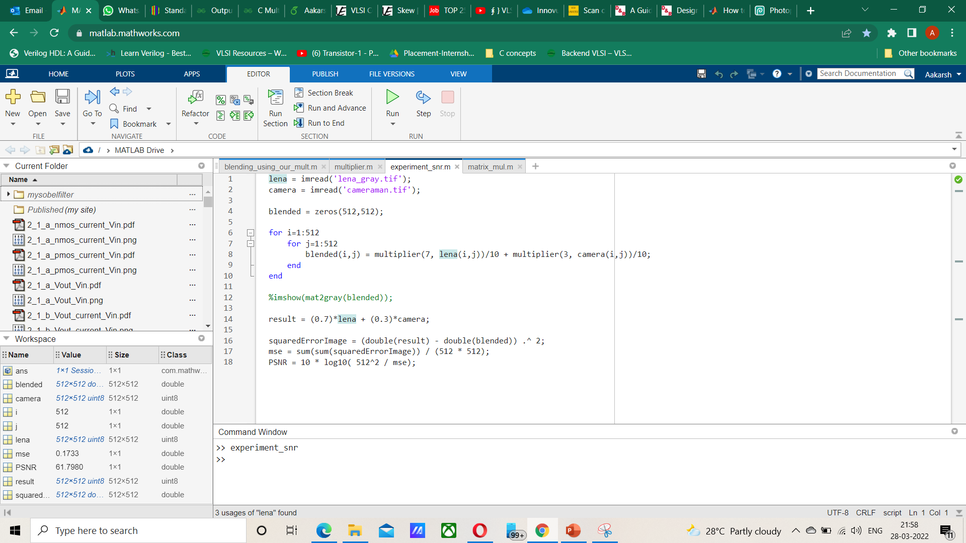

Slide 9
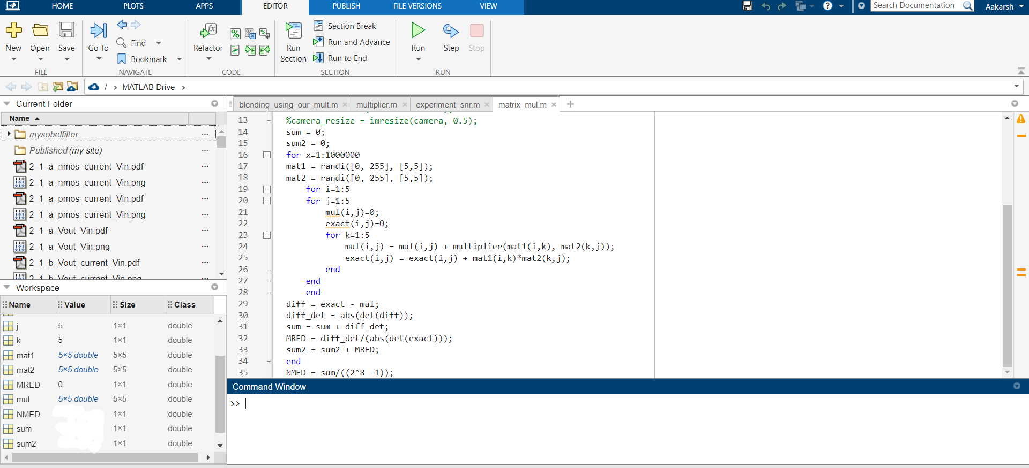

Slide 10
ERROR METRICS OF MATRIX MULTIPLICATION
COMPRESSOR | MRED | NMED
PRO1 PRO5 | 5.29 x 10^-4 | 8.44 x 10^-5
PRO2 | 7.71 x 10^-4 | 10.29 x 10^-5
PRO3 PRO4 | 4.05 x 10^-3 | 5.68 x 10^-4

